Slide 1
PREDICTING DEPRESSION FROM MENTAL HEALTH SURVEY USING DEEP LEARNING
DOMAIN – MENTAL HEALTH PREDICTION
Presented By
KEERTHANA A

Slide 2
WORK FLOW
Data Collection
↓
Data Preprocessing
↓
Exploratory Data Analysis (EDA)
↓
Deep Learning Model
↓
Hyperparameter Tuning
↓
Model Evaluation & Comparison
↓
Model Deployment Using Streamlit cloud
↓
Real-Time Depression Prediction

Slide 3
DATASET OVERVIEW & DATA PREPROCESSING
DATASET DETAILS
Train Dataset: 140,700 rows × 20 columns
Test Dataset: 93,800 rows × 19 columns
Numerical Features: 8
Categorical Features: 10
PREPROCESSING
Column Status | Result | Strategy
Numerical Columns | Missing Values Handled | Median Imputation
Categorical Columns | Missing Values Handled | Most Frequent Imputation
Overall Dataset | Dataset cleaned successfully | Outliers Analysed using Boxplots
Preprocessed dataset successfully prepared for model training

Slide 4
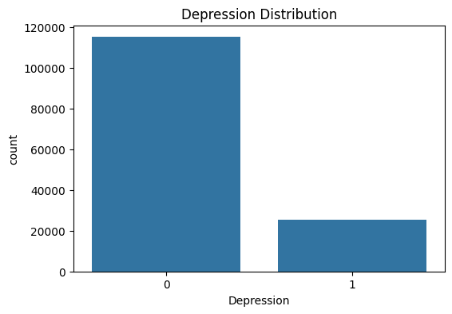
UNIVARIATE ANALYSIS
INSIGHTS
Most individuals belong to the non-depression class.
Dataset contains class imbalance.
Data distribution was analyzed before model training.

Slide 5
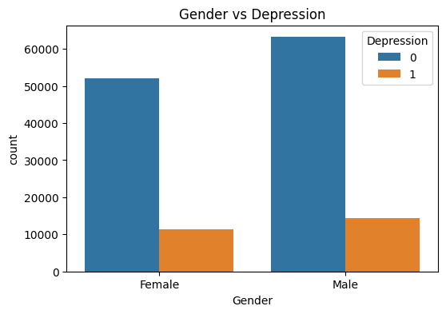
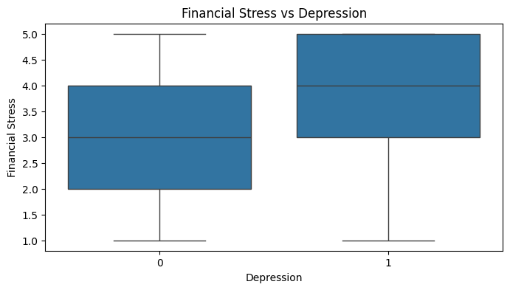
BIVARIATE ANALYSIS
INSIGHTS
Depression cases are slightly higher among males.
Higher financial stress is associated with depression.
Feature relationships were analyzed before model training.

Slide 6
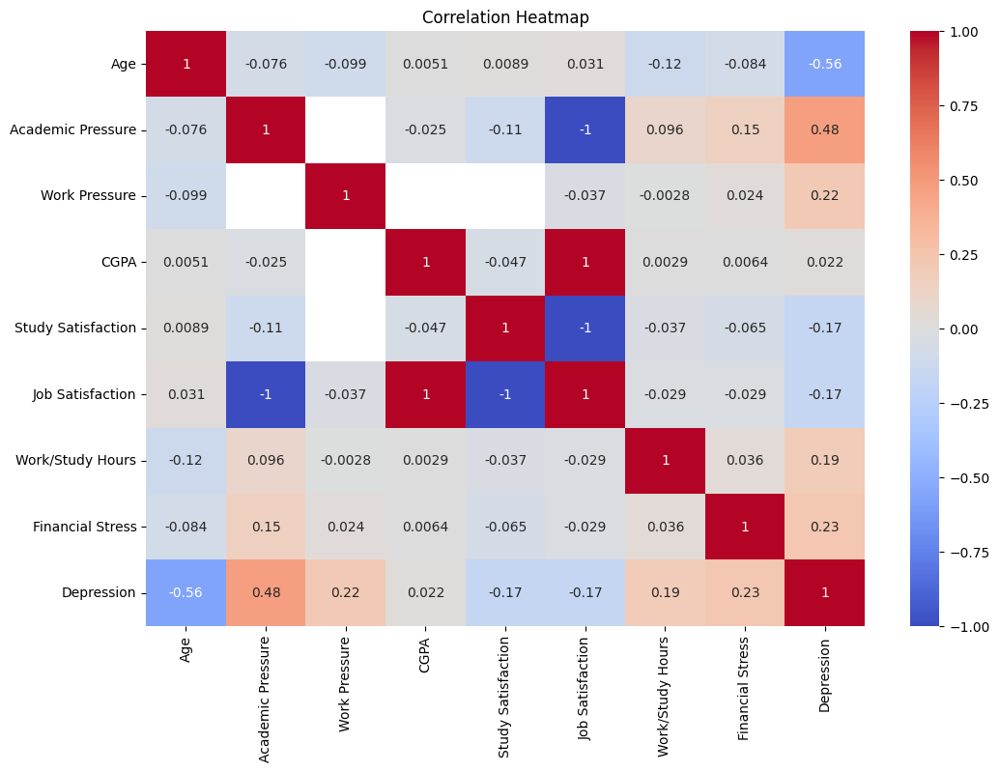
MULTIVARIATE ANALYSIS
INSIGHTS
Academic Pressure shows higher relation with depression.
Financial Stress and Work Pressure also influence depression.
Age has a negative correlation with depression.

Slide 7
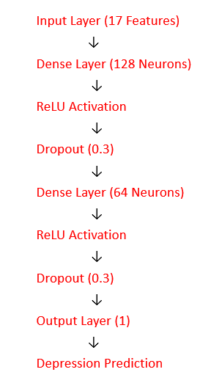
MODEL BUILDING & ARCHITECTURE
Input Data
↓
Preprocessing
↓
Train-Test Split
↓
Deep Learning Model
↓
Depression Prediction
• Deep Learning model developed using PyTorch
• Binary Classification Problem
• Dataset split into Train and Test sets
• Feature Scaling applied using StandardScaler
• Model trained for 100 epochs
Component | Purpose
ReLU | Non-linear learning
Dropout | Prevent Overfitting
Adam | Optimization
BCEWithLogitsLoss | Binary Classification Loss

Slide 8
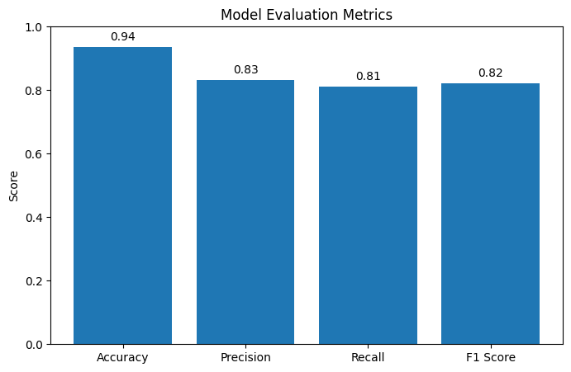
DEEP LEARNING MODEL PERFORMANCE
Metric | Score
Accuracy | 93.58%
Precision | 83.15%
Recall | 81.10%
F1 Score | 82.11%
The deep learning model achieved high accuracy with balanced precision and recall.

Slide 9
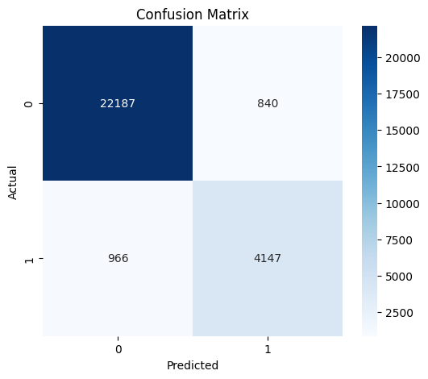
CONFUSION MATRIX
INSIGHTS
High True Negative and True Positive values.
Model predictions are mostly accurate.
Low False Positive and False Negative rates.

Slide 10
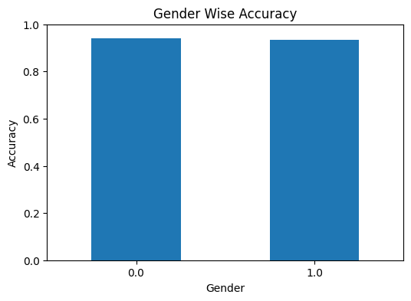
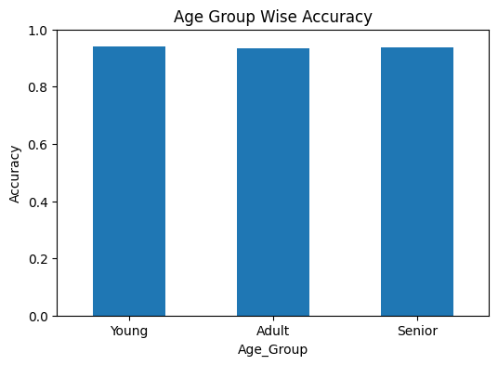
BIAS EVALUATION
Insights
Model performance is balanced across genders.
Similar accuracy observed across age groups.
Indicates reduced prediction bias.

Slide 11
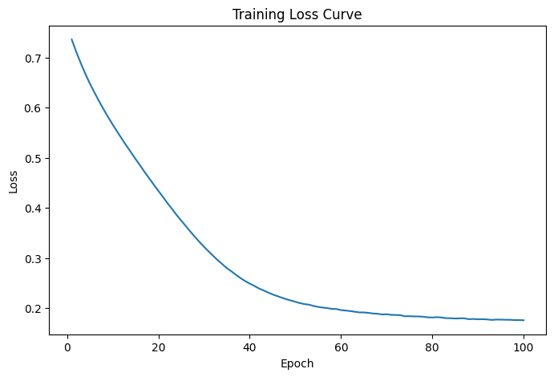
TRAINING LOSS CURVE
INSIGHTS
Training loss consistently decreased across epochs.
Loss stabilization indicates effective learning and convergence.
No major fluctuations observed during training.

Slide 12
HYPERPARAMETER TUNING
Multiple parameter combinations were tested
Different hidden layer sizes were evaluated
Dropout values were tuned
Learning rates were optimized
Epoch values were compared
Hidden Layers | Dropout | Learning Rate | Epochs | F1 Score
[64, 32] | 0.2 | 0.001 | 100 | 0.811
[128, 64] | 0.2 | 0.001 | 100 | 0.820
[128, 64] | 0.3 | 0.001 | 100 | ⭐ 0.821
“Best performance was achieved using hidden layers [128, 64], dropout 0.3, learning rate 0.001, and 100 epochs.”

Slide 13
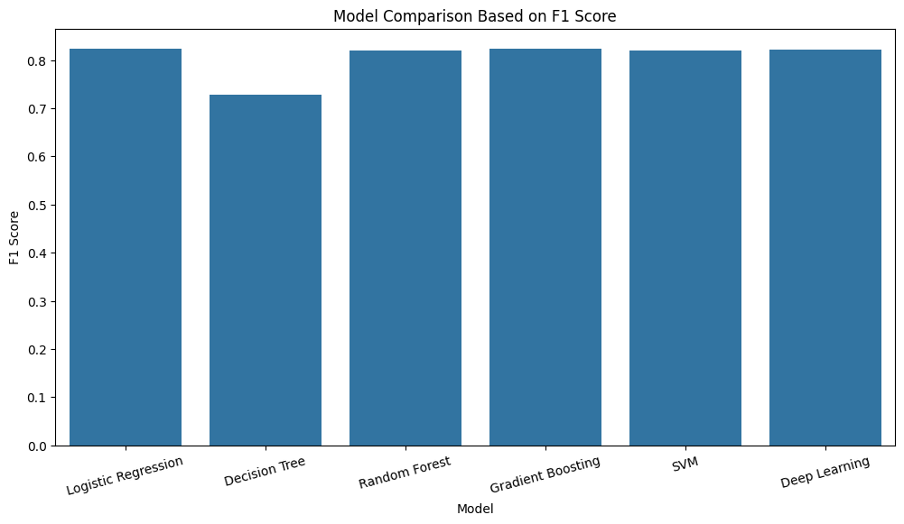
MODEL COMPARISON & FINAL MODEL SELECTION
Multiple Machine Learning models were evaluated.
Deep Learning model produced balanced performance.
High Accuracy and F1 Score were achieved.
Deep Learning was selected as the final deployment model

Slide 14
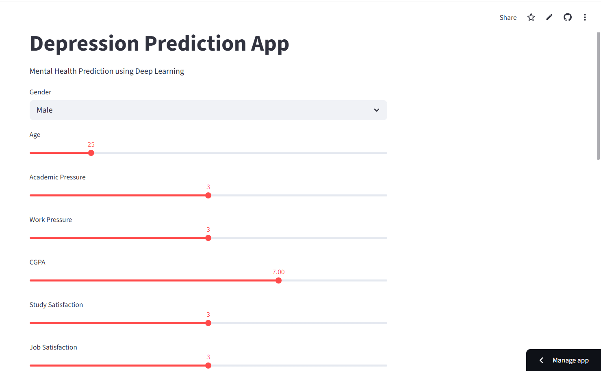
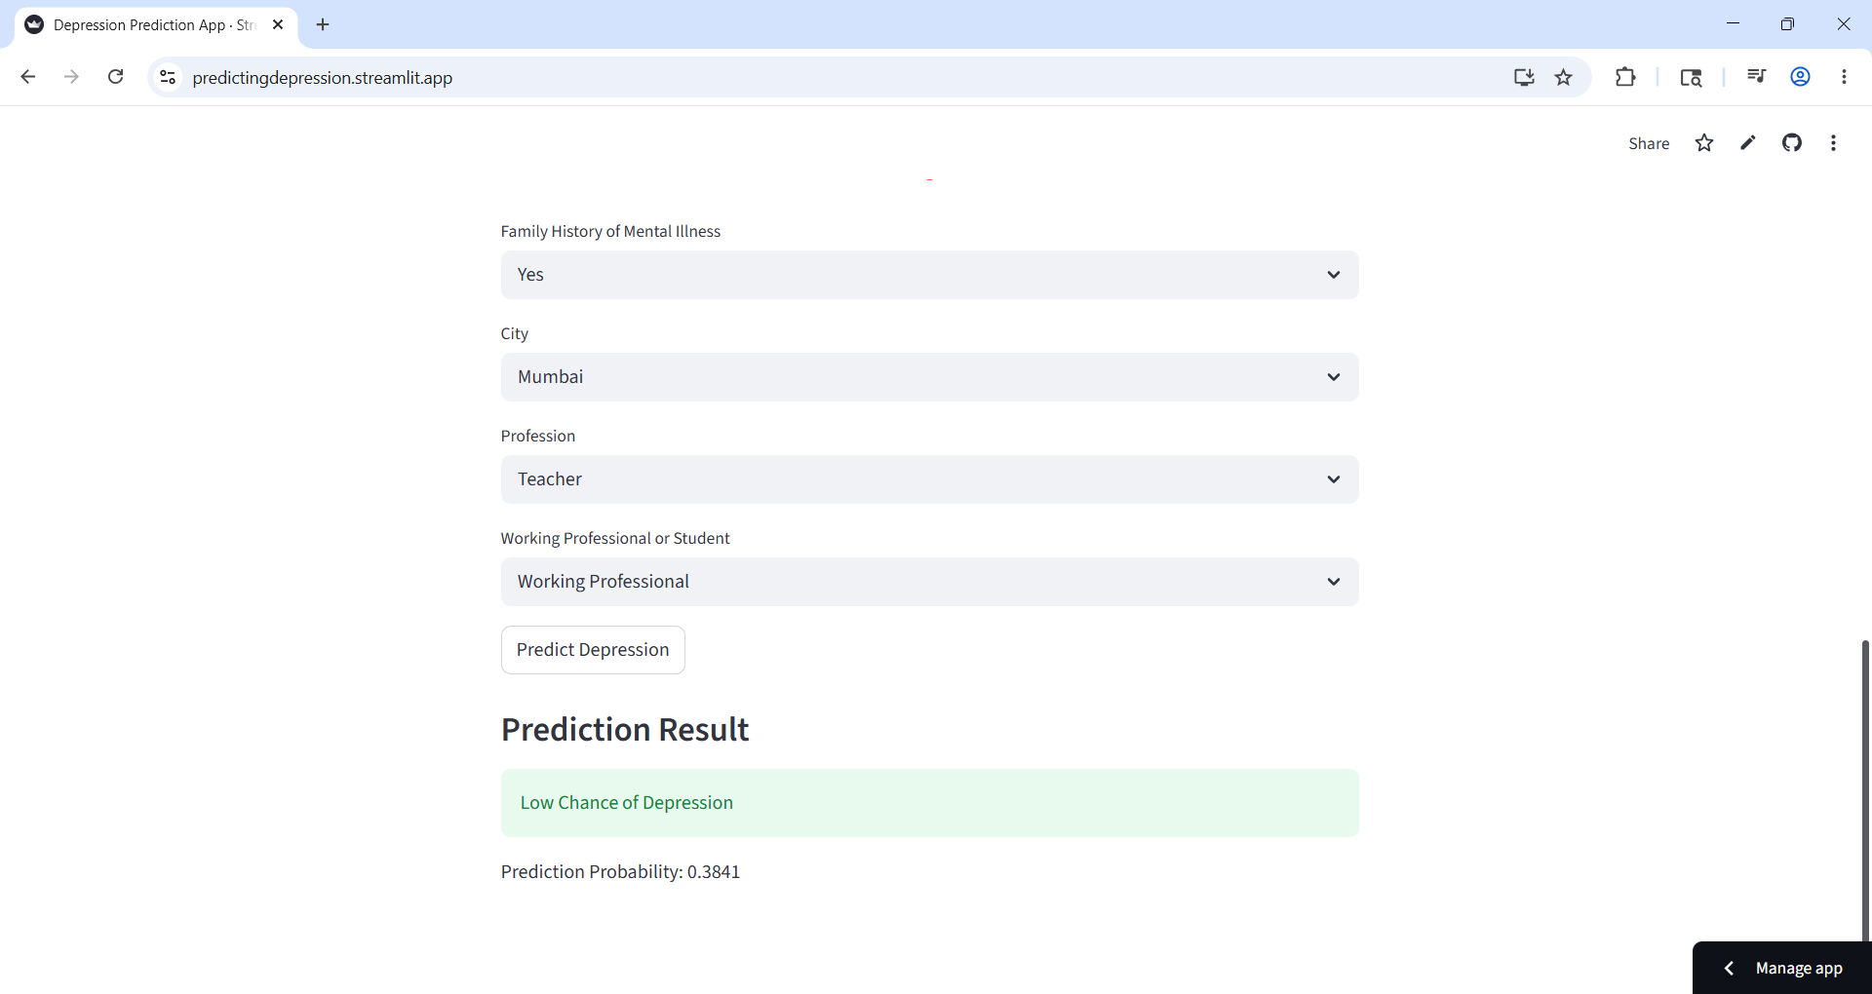
STREAMLIT CLOUD DEPLOYMENT
The Depression Prediction system was deployed using Streamlit Cloud.
Users can enter mental health details and receive real-time depression predictions using the Deep Learning model.
Deployment Link:
https://predictingdepression.streamlit.app/

Slide 15
CONCLUSION
End-to-end depression prediction system developed successfully.
Deep Learning model achieved good prediction performance.
Model deployed using Streamlit Cloud for real-time prediction.
System helps in early depression risk identification.

